Slide 1
Dr.KHAWLA Bouafia
Telecommunication Network – Practice-

Slide 2
Dr. Khawla Bouafia
Department of Information System
Eotvos Lorand University (ELTE)
Budapest, Hungary
Email: bouafia@inf.elte.hu
Office: 2-519

Slide 3
Practice 09

Slide 4
Mininet

Slide 5
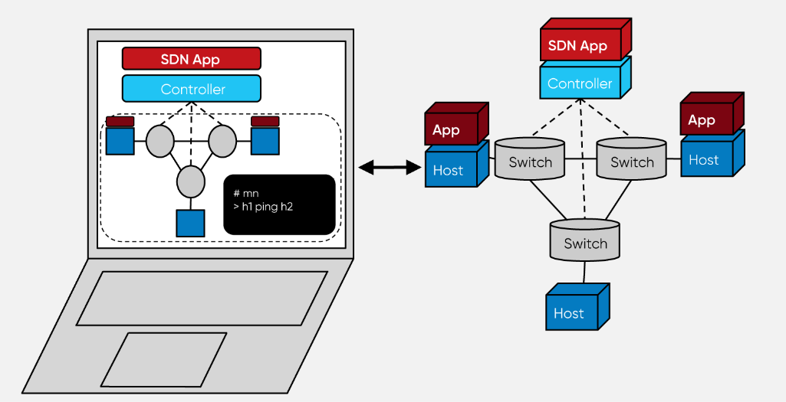

Slide 6
Mininet
Mininet is a tool for software-defined networks. It is an emulator of a network, and it is used to visualize the switches and application of software-defined networks in a virtualized environment.
It is also used to test the software-defined network devices and those using OpenFlow protocols. The switches used in Mininet are OpenFlow switches.

Slide 7
Methods to Install Mininet:
Install Mininet as a virtual machine provided having a virtual box installed already
By installing it directly from the source.
By installing it from the package.
By upgrading the currently existing Mininet.

Slide 8
Features of Mininet
Mininet provides us the space to develop and test our software-defined network applications without the need to set up a physical environment.
It gives us a network testbed thereby allowing us to develop and test applications that are using OpenFlow protocols.
It can be used without programming also.

Slide 9
It also gives us the flexibility to integrate python API, thereby paving the way for creating and experimenting with networks.
It also has a CLI(Command Line Interface) which is aware of topology and OpenFlow thereby allowing us to debug or run network tests for our application.

Slide 10
Advantages of Mininet :
It is very fast and takes very little time for booting.
It is easy to install and use.
It saves money because the emulators are cost-effective instead of testing with hardware devices.
It is also very easy to connect with real-world network devices.
It has high availability.

Slide 11
Mininet User interface :
Mininet can be controlled using Graphical User Interface while creating and visualizing the topology in the graphic environment

Slide 12
MiniEdit, Mininet’s GUI
The Mininet network simulator includes MiniEdit, a simple GUI editor for Mininet.
MiniEdit is an experimental tool created to demonstrate how Mininet can be extended.

Slide 13
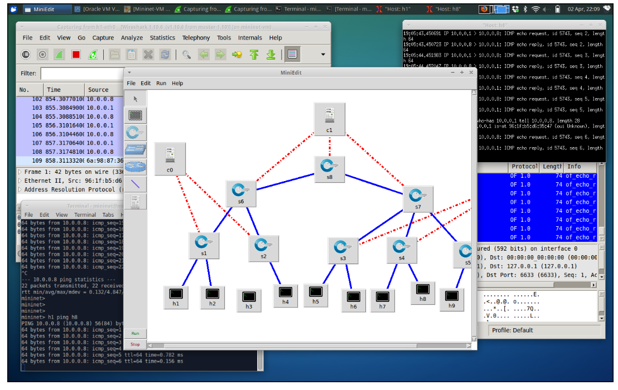

Slide 14
Python interfaces For mininet
Mininet is available as a package and can be imported using python. We can also communicate and control the Mininet nodes by writing the scripts in python.

Slide 15
THE END

